Slide 1
LASER TECHNOLOGY
By
Dr P S Reddy
Department of Physics
NIT Goa

Slide 2
WHAT IS LASER
?

Slide 3
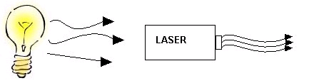
Incandescent vs. Laser Light
Monochromatic
Directional
Coherent
Long wave drives
High Intensity
Many wavelengths
Multidirectional
Incoherent

Slide 4
Interaction of radiation with matter
Absorption
Spontaneous Emission
Stimulated Emission

Slide 5
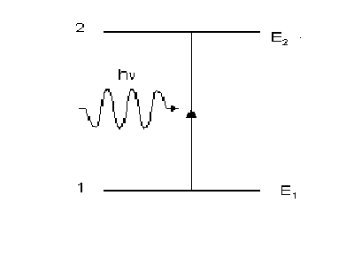
Absorption
Energy is absorbed by an atom, the electrons are excited into vacant energy shells.

Slide 6
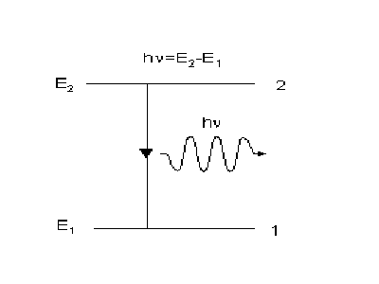
Spontaneous Emission
The atom decays from level 2 to level 1 through the emission of a photon with the energy hv. It is a completely random process.

Slide 7
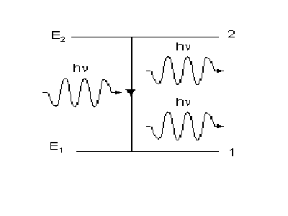
Stimulated Emission
atoms in an upper energy level can be triggered or stimulated in phase by an incoming photon of a specific energy.

Slide 8
Two-level Laser System
Unimaginable
as absorption and stimulated processes neutralize one another.
The material becomes transparent.

Slide 9
Two-, three-, and four-level systems
It took laser physicists a while to realize that four-level systems are best.
Two-level system
Three-level system
Four-level system
Fast decay
Fast decay
Pump Transition
Pump Transition
Laser Transition
Laser Transition
Laser Transition
Pump Transition
Fast decay
At best, you get equal populations. No lasing.
If you hit it hard, you get lasing.
Lasing is easy!

Slide 10
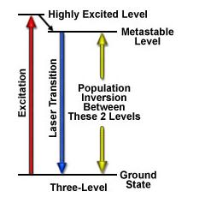

Three-level Laser System
Initially excited to a short-lived high-energy state .
Then quickly decay to the intermediate metastable level.
Population inversion is created between lower ground state and a higher-energy metastable state.

Slide 11
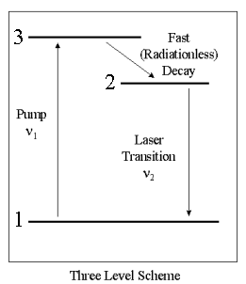
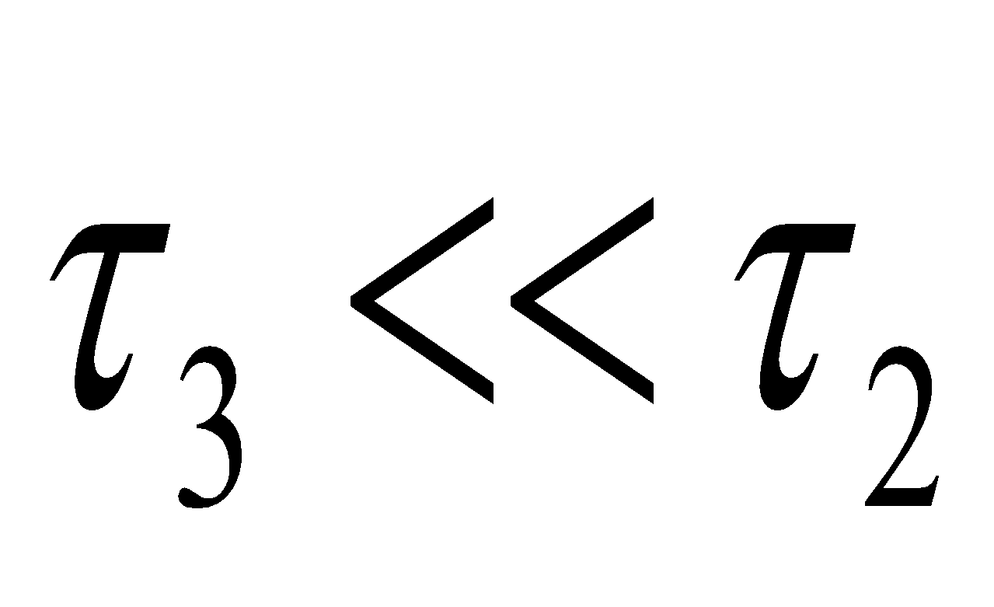
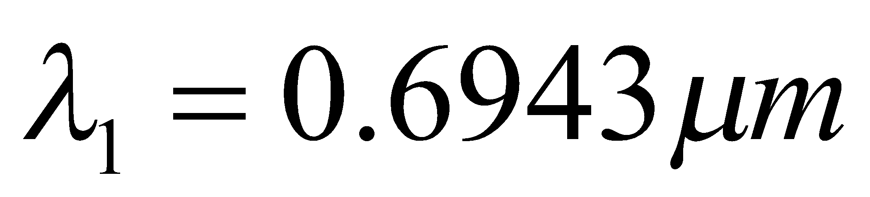
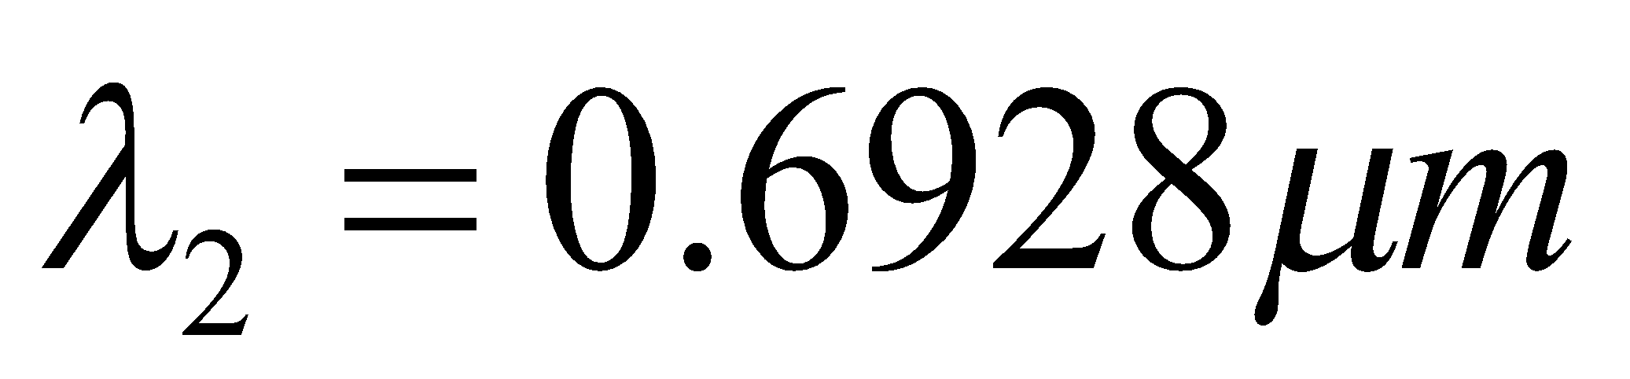

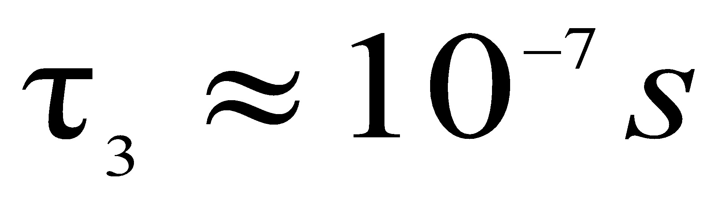
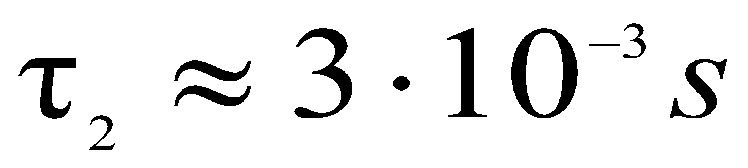
Ruby laser

Slide 12
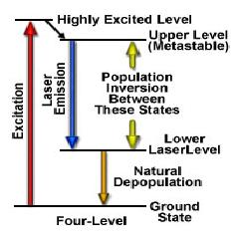
Four-level Laser System
Laser transition takes place between the third and second excited states.
Rapid depopulation of the lower laser level.

Slide 13
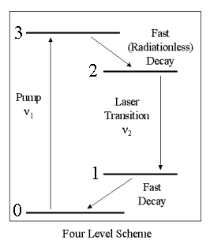
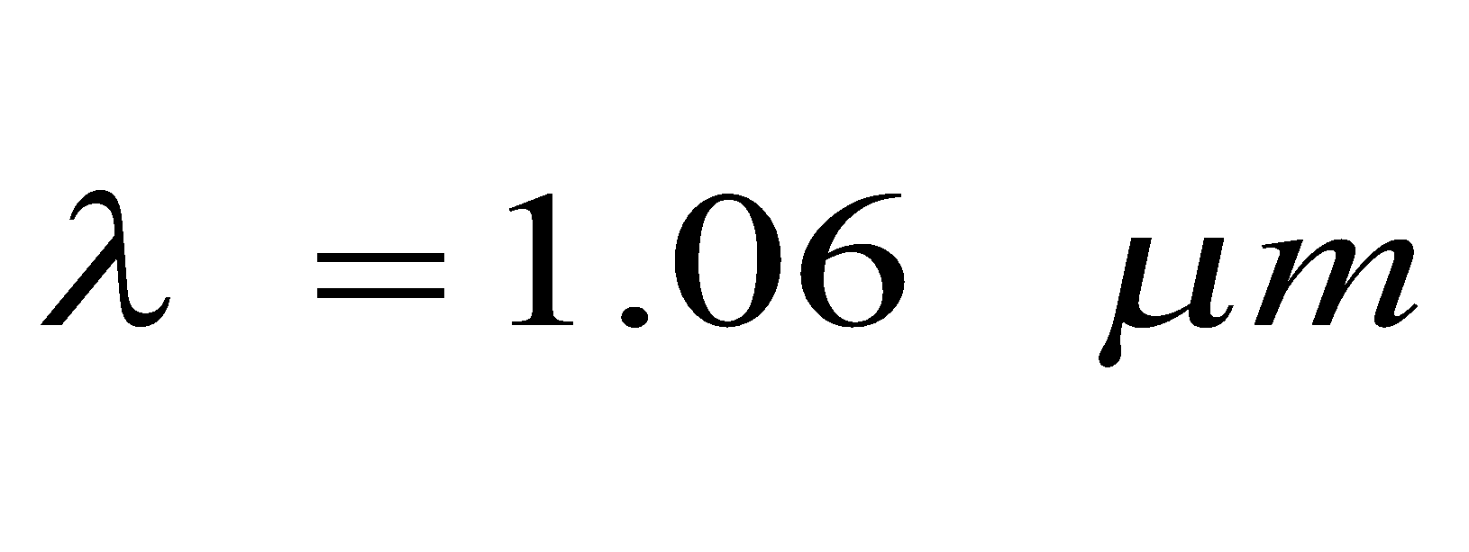
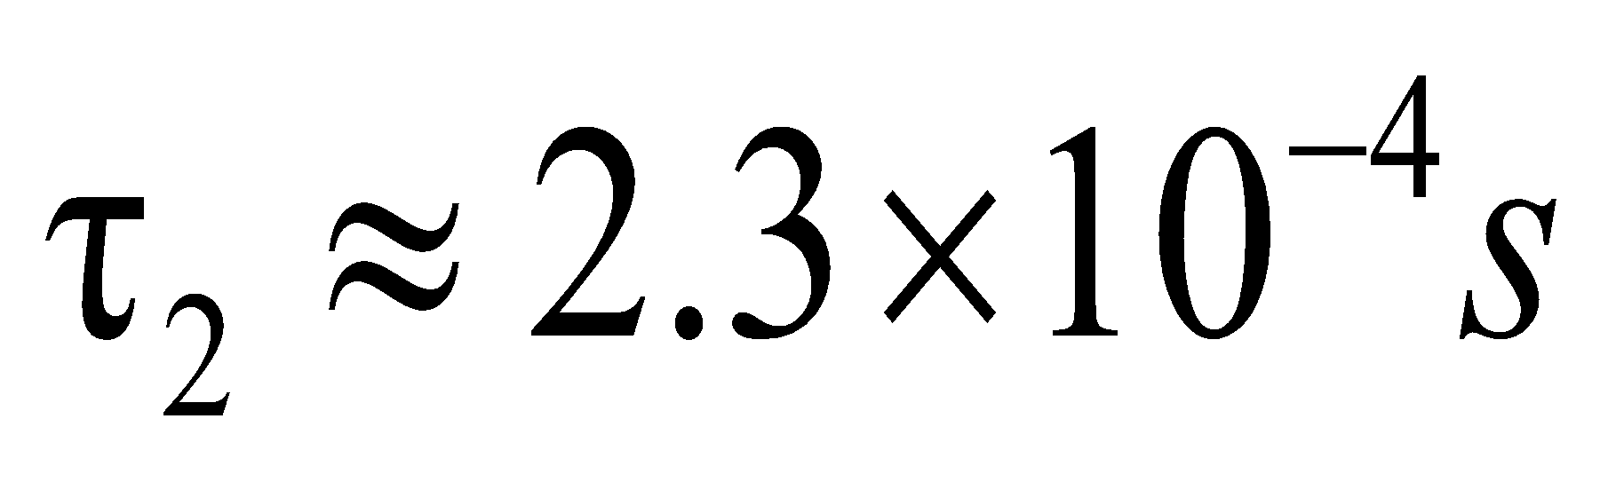
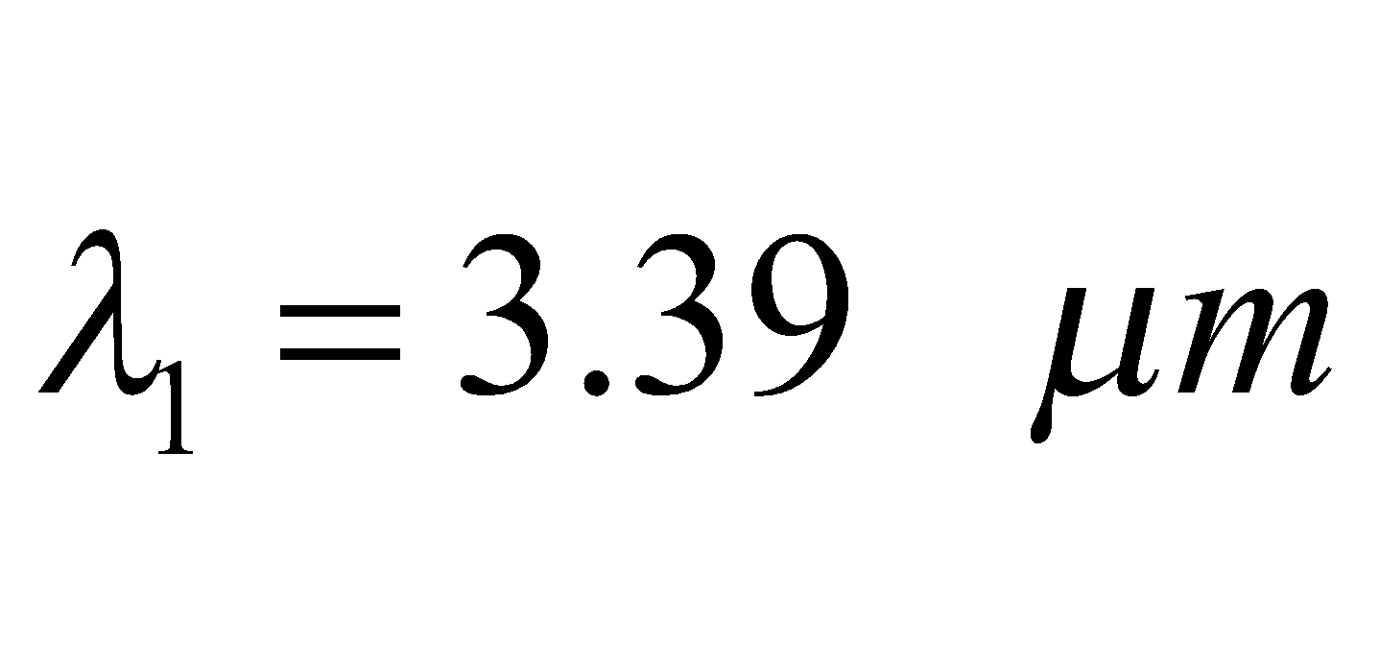
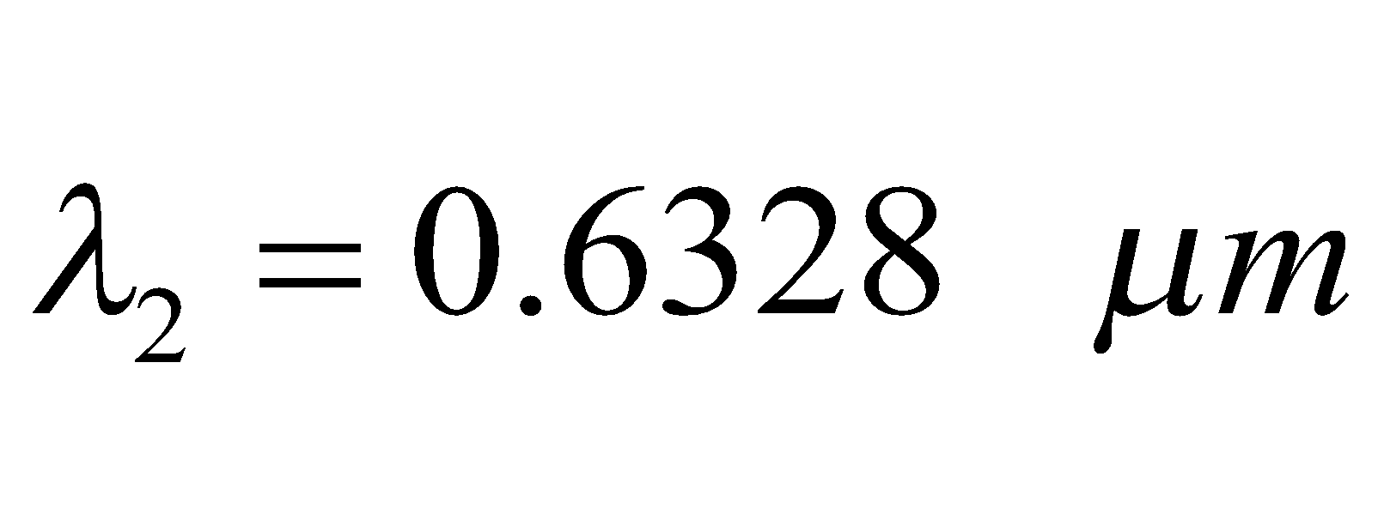
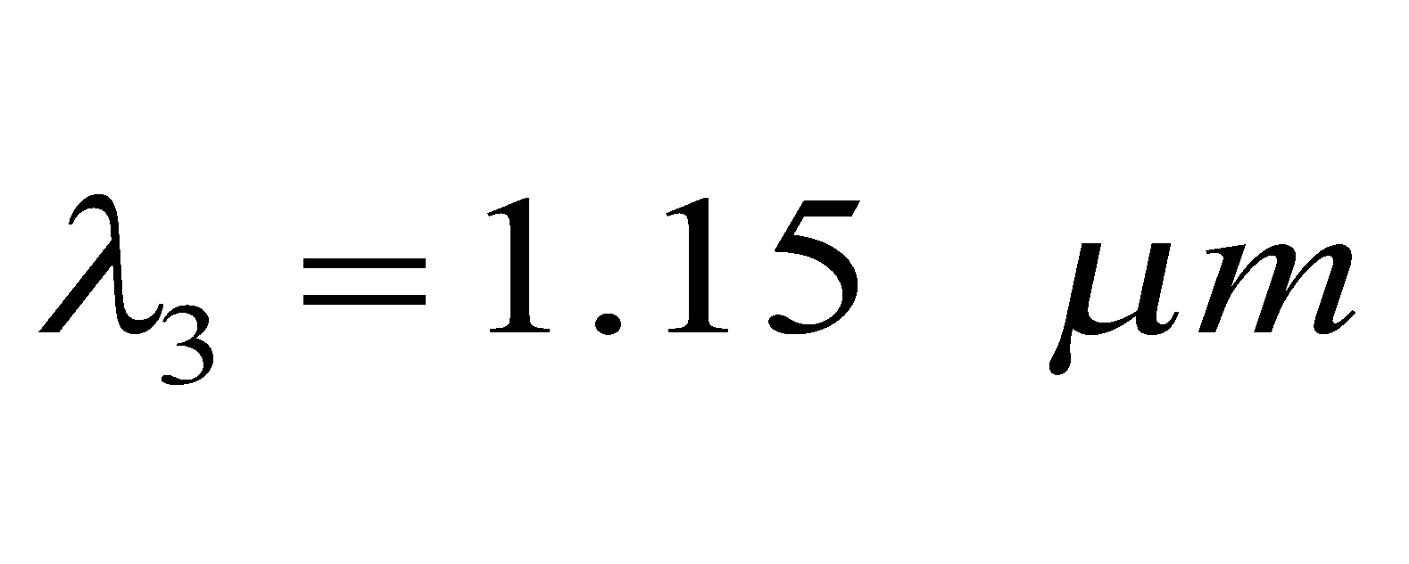
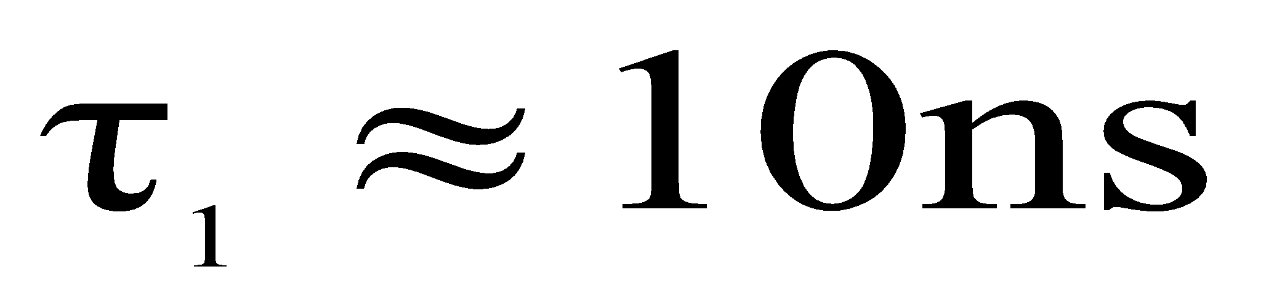
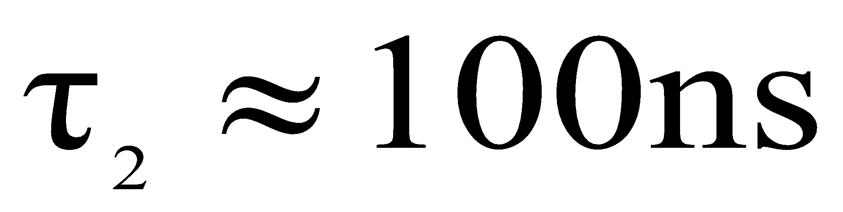
Nd:YAG laser
He-Ne laser

Slide 14
Laser Output
Continuous Output (CW)
Pulsed Output (P)
Energy
Energy
Time
Time

Slide 15
Main components of a laser
Medium
Excitation mechanism
Cavity (or) resonator

Slide 16
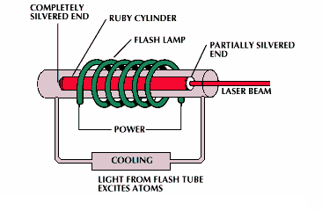
Excitation mechanism

Slide 17
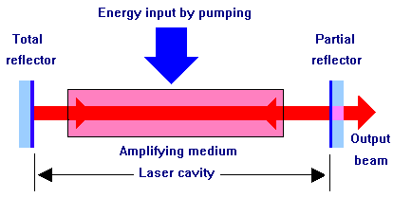
Resonator
Confines light within the excitable medium, thus tttassuring stimulated emission

Slide 18
Lasing Action

Slide 19
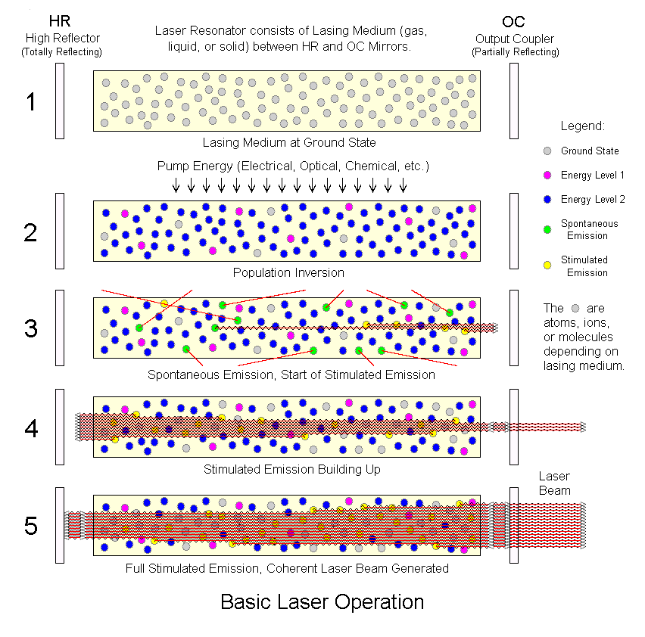

Slide 20
Laser Types
According to the active material:
Gas ,Solid-state, Dye, Semiconductor lasers, Excimer and Doped fiber lasers
According to the wavelength:
infra-red, visible, ultra-violet (UV) or x-ray lasers.

Slide 21
Gas Lasers
Atomic
Molecular
Ionic

Slide 22
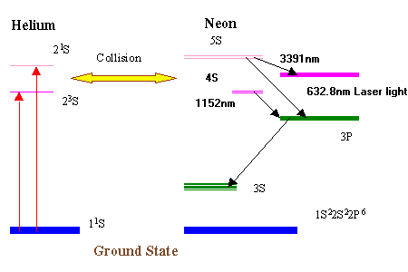
He-Ne laser

Slide 23
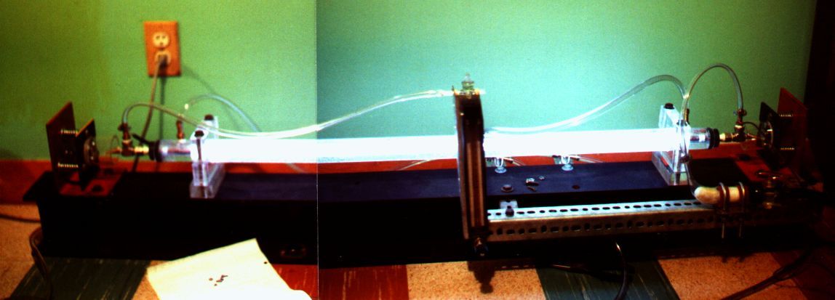
CO2 gas laser

Slide 24
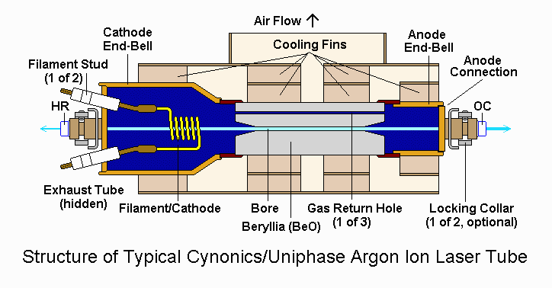
Ionic Laser

Slide 25
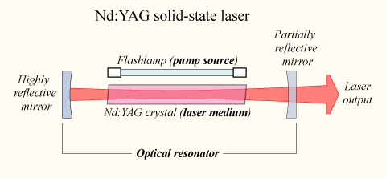

Slide 26
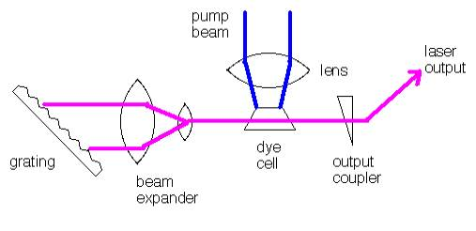
DYE LASER
Schematic diagram of a dye laser
A dye laser can be considered to be basically a four-level system.
The energy absorbed by the dye creates a population inversion, moving the
electrons into an excited state.

Slide 27
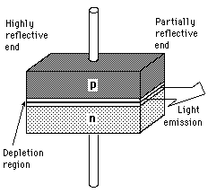
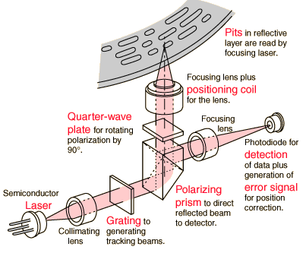
Semiconductor lasers
photon production by electron hole pair recombination as in LED
above a treshold current, stimulated emission occurs -> lasing
CD player: GaAs, 5mW, 840 nm
L =n λ
Laser printer: AlGaAs, 50mW, 760 nm
Telecom: GaInAlP, 20 mW, 1300 nm
compact, cheap, variable wavelength

Slide 28
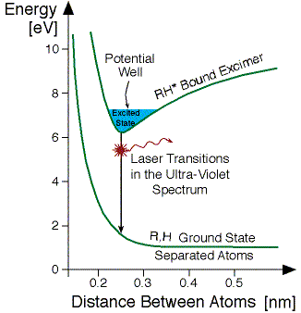
Energy levels in the Excimer Laser
R:noble gas atom
H:halogen

Slide 29
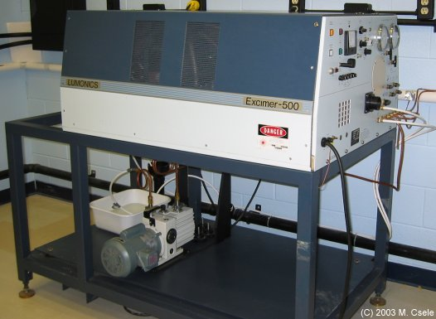
Excimer laser Diagram

Slide 30
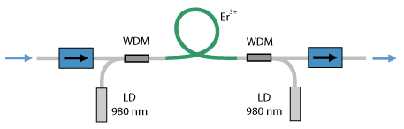
Erbium-doped fiber amplifier (EDFA)
Er dopant added to core
Pump at 980nm with laser diode

Slide 31
Applications
Scientific
Military
Medical
Industrial and commercial
Communication

Slide 32
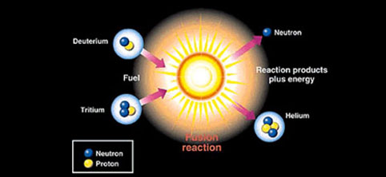
Scientific
. Spectroscopy
. Lunar laser ranging
. Photochemistry
. Laser cooling
. Nuclear fusion

Slide 33

Military
. Death ray
. Defensive applications
. Strategic defense initiative
. Laser sight
. Illuminator
. Rangefinder
. Target designator

Slide 34

Medical
. eye surgery
. cosmetic surgery

Slide 35
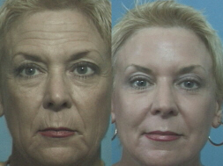
Laser Resurfacing (CO₂) Laser skin resurfacing refers to a skin peeling procedure which uses a specific wavelength of light to selectively eliminate:
Fine lines
Wrinkles,
Acne scars
Unwanted Skin Blemishes
Keloid Scars

Slide 36
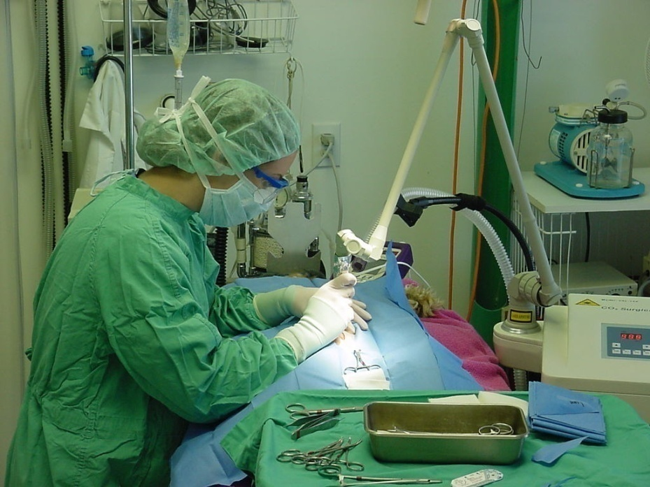
“Laser Scalpel”
Increased precision
Microsurgery
Improve operations tttvia endoscopes
Diagnostic imaging
Numerous other tttapplications

Slide 37
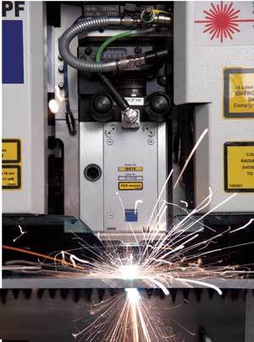
Industry & Commercial
. cutting, welding, marking
. CD player, DVD player
. Laser printers, laser pointers
. Photolithography
. Laser light display

Slide 38
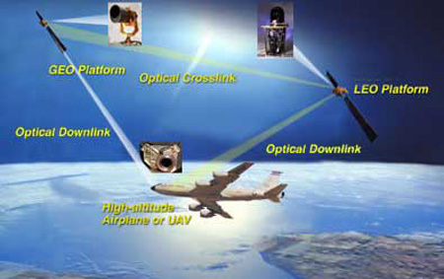
Communication
Doped fibers for amplification
Laser diodes
Optical connectivity's

Slide 39
http://demonstrations.wolfram.com/LowerExcitedStatesOfHeliumAtom/

